Slide 1

HTML5 & CSS3
Fundamentals
Week 1 – Full-Stack DPP Course

Slide 2
Welcome
Tanveer Ahmad
Technical Trainer
DPP

Slide 3
Learning outcomes
House keeping
Health and Safety
HTML, CSS and JavaScript
Website Wireframes
Domain name and hosting
New tags and features in HTML 5
HTML tags, attributes and values

Slide 4




Just IT housekeeping rules
In the event of a fire alarm, make your way to the closest fire exit: the main entry or fire exit door by the kitchen. The meeting point is outside Tesco Metro located on the north side of Plumber’s Row.
Please use the toilets thoughtfully and keep them tidy for others. If the toilets are in an unsuitable condition then please speak to a trainer or the front desk support.
Smoking is prohibited outside the main building doors, please go to the side away from the door

Slide 5



Just IT housekeeping rules
The kitchen utilities are available for students, please keep it tidy.
Students are free to eat and drink in the classroom at lunchtime or breaks.
Lunch times / breaks and daily finish times are to be directed by the trainer.

Slide 6

Just IT housekeeping rules
Do not adjust the room air-con or open windows; please discuss with the trainer if temperature is an issue.

Slide 7

Agenda
Introduction
Sales presentation at around 9:30am
We all going for lunch at 1pm
Coding…
Any questions?

Slide 8
Classroom Rules
There are no rules – we all adults
Just respect each other
Work together
Collaborate and create lasting friendships

Slide 9
Health & Safety
If you feel unwell please let me know
Info about the building
Careful with cables and drinks
Get breaks away from the screen
Make sure you are comfortable

Slide 10
Class Structure
Start at 9:30am
Break in between (10-15 min)
Lunch break at 1pm (for an hour)
Break in between (10-15 min)
We finish at 4:00pm

Slide 11

What is our training approach
I am a great believer that practice makes perfect and for coding, you learn better by doing.
HANDS-ON CODING

Slide 12
Are there any questions?

Slide 13



The Web Development Trifecta
HTML5 – structures and describes Web page content
CSS3 – provides the formatting and "look" of a Web page
JavaScript – adds interactive, dynamic capabilities to Web pages

Slide 14
Semantic Markup and Separation of Concerns
Semantic HTML is the use of HTML markup to reinforce the semantics, or meaning, of the information in web pages and web applications rather than merely to define its presentation or look.
The practice of adding technology in layers to a website to ensure that if all fails, content can still be accessed.
Separation of concerns
HTML
CSS
JAVASCRIPT
CONTENT
PRESENTATION
BEHAVIOUR

Slide 15
Why Use Semantic Elements
There are many advantages for using Semantic HTML5 Elements:
Makes the website meaningful to search engines
Makes the code easier to maintain and readable
Makes the website more accessible to people with disability
SEARCH ENGINES
MAINTAIN CODE
ACCESSIBILITY

Slide 16

Website Wireframes
Company logo
Full screen background image
Hero section image
Support Text
Company Slogan
Action Button

Slide 17
Website Wireframes
Lizhe Tan
Company Logo
Menu
Company Logo
Menu
Company Slogan
Company Slogan
Full screen background image
Hero section image
Full screen background image
Hero section image
Support Text
Support Text
Action Button
Action Button

Slide 18

Domain name and
Website Hosting

Slide 19
Hosting account and GitHub
Open a hosting account with one.com/SmarterASP.net and also buy a domain name. Once that is done, we will create a FREE account with GitHub.
one.com
GitHub
Pluralsight GitHub Tutorial

Slide 20
Resources

Slide 21

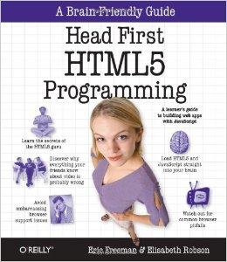
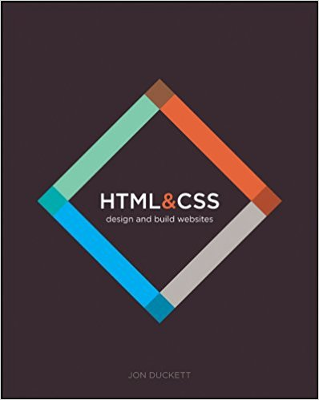
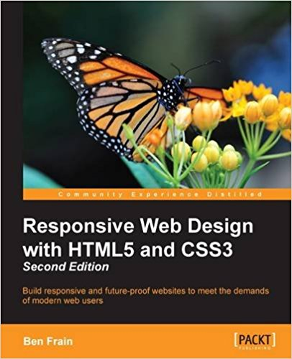
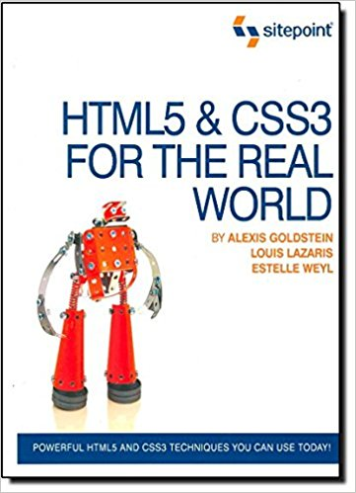
Resources
Pluralsight video tutorials
HTML5 & CSS3 (Note: The books are only suggestions)
Introduction to Web Development
Learn Basic HTML5 & CSS3
Beginner - Pluralsight
HTML5 Fundamentals
Beginner - Pluralsight

Slide 22
Resources cont.
Relevant HTML5 websites for sample codes, examples and general information.
HTML5 w3schools
W3C
HTML5 MDN
Stack Overflow
Can I Use
Awwwards

Slide 23
HTML
Hypertext Markup Language

Slide 24
What is HTML5?
Is a collection of standards including CSS3 and JavaScript are part of the new definition:
HTML5 is the newest version of HTML and replaces HTML4
Eliminates the need and use of plugins such as Flash and Silverlight
HTML5 is cross-platform application
Visit the W3C website for:
HTML5 History

Slide 25
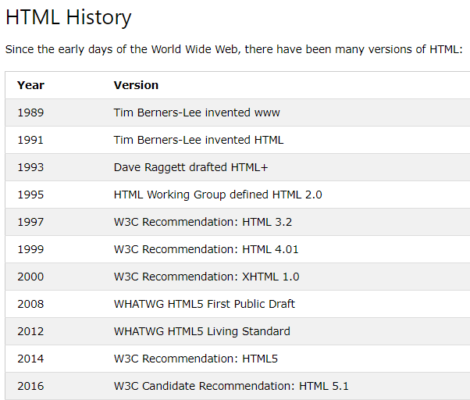
HTML History

Slide 26
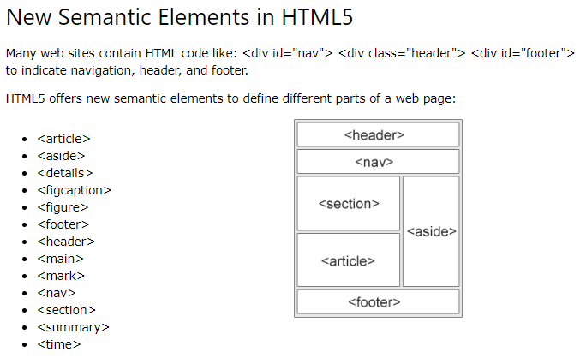
New Semantic Elements
https://www.w3schools.com/html/html5_semantic_elements.asp

Slide 27
HTML5 New Features
New elements and attributes
Support for CSS3
New form controls
Video and audio integration
Graphics using Canvas
SVG
Drag and drop
Web storage
Geolocation

Slide 28
Code Example – Basic HTML Page
<!DOCTYPE html>
<html>
<head>
<meta charset="UTF-8">
<title>Page Title</title>
</head>
<body>
<h1>This is a Heading</h1>
<p>This is a paragraph.</p>
</body>
</html>
Document type for browser is HTML
Start of HTML always with end /HTML

Slide 29
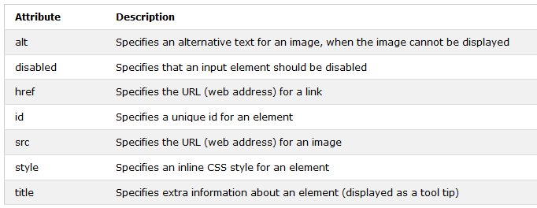
HTML attributes
HTML tags have attributes which provide additional functionalities.
Some attributes are optional (style, align etc) and some attributes are required (for example src in <img>).
Attributes usually come in name/value pairs like: name="value“
<h1 style="border: 2px solid Tomato;">Hello World</h1>

Slide 30
Some HTML tags
<h1> …… <h6>
<p>
<q> tag to put double quotes around the text in a <p> tag
<br>
<hr>
<a href="https://www.justit.co.uk"> Just IT </a>
<img src=“imgs\mypic.jpg" alt=“Author’s Pic" width=“200" height=“300">
Comments <!--- comments --→
<abbr>
<p>The <abbr title="World Health Organization">WHO</abbr> was founded in 1948.</p>

Slide 31
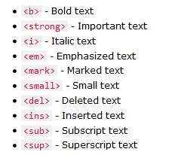
HTML formatting tags
<!-- Write your comments here -->

Slide 32
HTML <blockquote> for Quotations
The HTML <blockquote> element defines a section that is quoted from another source.
<p> Browsers usually indent blockquote elements.</p>
<blockquote cite="http://www.worldwildlife.org/who/index.html">
For 50 years, WWF has been protecting the future of nature.
The world's leading conservation organization,
WWF works in 100 countries and is supported by
1.2 million members in the United States and
close to 5 million globally.
</blockquote>

Slide 33
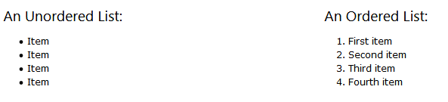
HTML Lists
The type attribute of the <UL>
Value | Description
disc | Sets the list item marker to a bullet (default)
circle | Sets the list item marker to a circle
square | Sets the list item marker to a square
none | The list items will not be marked

Slide 34
Description Lists
A description list is a list of terms, with a description of each term.
The <dl> tag defines the description list, the <dt> tag defines the term (name), and the <dd> tag describes each term
<dl> <dt>HTML</dt> <dd> Hypertext Mark-up Language </dd> <dt>CSS </dt> <dd>Cascading Style Sheets </dd> </dl>

Slide 35
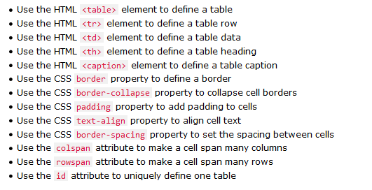
HTML Table
An HTML table is defined with the <table> tag.
Each table row is defined with the <tr> tag.
A table header is defined with the <th> tag. By default, table headings are bold and centered.
A table data/cell is defined with the <td> tag.

Slide 36
CSS the Basics
CSS: Cascading Style Sheets
We can separate mark-up and styling code
Link our styles to our webpage
Manipulate the layout of our webpage
Style different elements within our webpage
CSS3 History

Slide 37
CSS stands for Cascading Style Sheets
CSS describes how HTML elements are to be displayed on screen, paper, or in other media.
CSS can be added to HTML elements in 3 ways:
Inline - by using the style attribute in HTML elements
An inline CSS is used to apply a unique style to a single HTML element.
Internal - by using a <style> element in the <head> section
An internal CSS is used to define a style for a single HTML page.
External - by using an external CSS file
An external style sheet is used to define the style for many HTML pages.

Slide 38
The CSS Box Model
Margin
Border
Padding
Content

Slide 39
Useful Websites
Free images: https://unsplash.com
https://www.w3schools.com/html/html_basic.asp
https://www.madebymike.com.au/demos/html5-periodic-table/
https://www.lipsum.com
Icons https://fontawesome.com
https://pixlr.com/
https://compressor.io/
https://fonts.google.com/
http://html5doctor.com/

